Slide 1
Final Project: Eye Blinking Detection and Remote Access to IoT Sensors and Devices
Team Hard Coders
Raymond Fey, Javier Garcia, Ifeanyi Anyika
ECE 6372– Advanced Hardware Design

Slide 2
Part 1
Part 2
Part 4
System Architecture and
Design Layouts Walkthrough
Table of Contents
Modules/Script Walkthrough
Part 3
Design Compromises
and Complications
Short Video Demo

Slide 3
Part 1 System Architecture/ Design Layouts

Slide 4
What are we designing?
The system will allow a single client to use the eye-blinking detection application on the Raspberry Pi to control certain aspects of Internet of Things (IoT) devices connected to them, along with requesting help from a remote user. The remote user will be able to view certain sensor data, send messages, and remotely control the IoT devices from a web application on an Android smartphone.

Slide 5





Features
Eye Blinking Detection
Web Server
IoT Interaction
Android WebApp
Clean User Interface

Slide 6
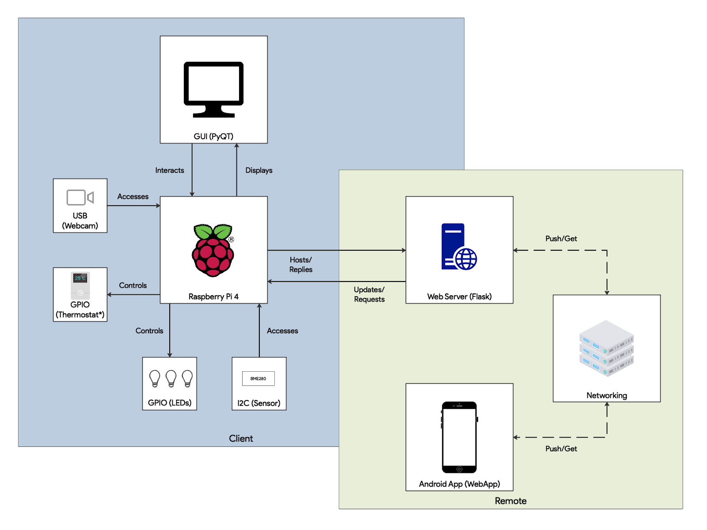
Top Level System Architecture Diagram

Slide 7




Software Libraries and Dependencies Used
And a couple others…

Slide 8
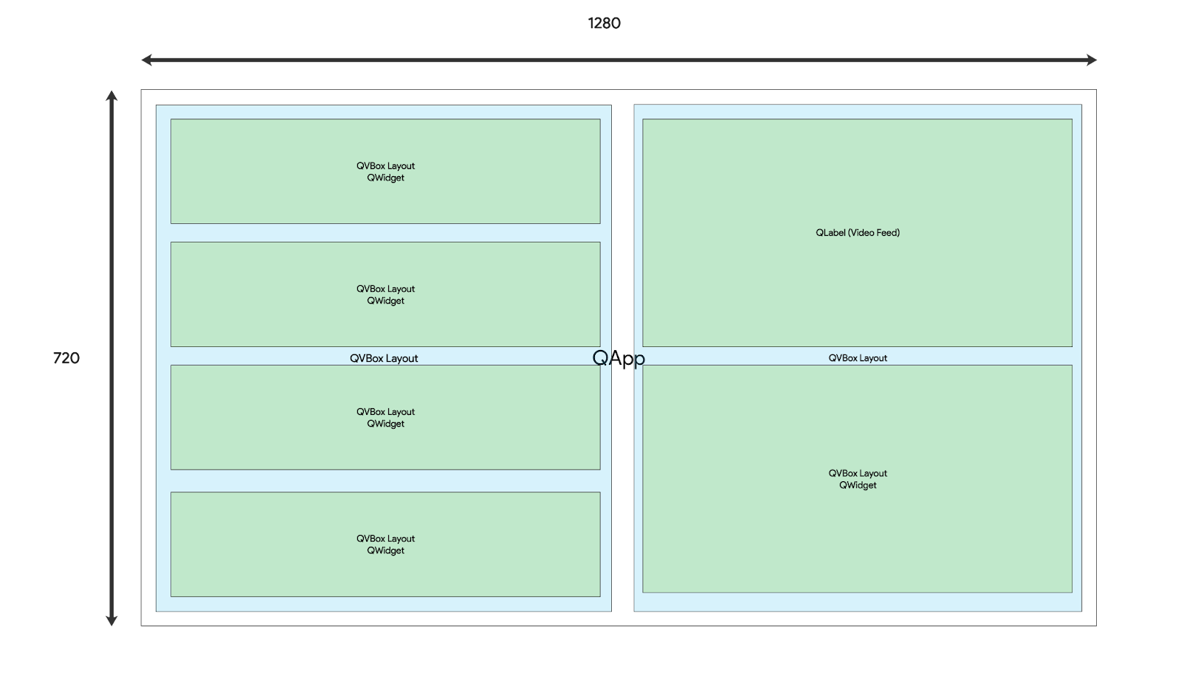
Raspberry Pi Application General Layout

Slide 9
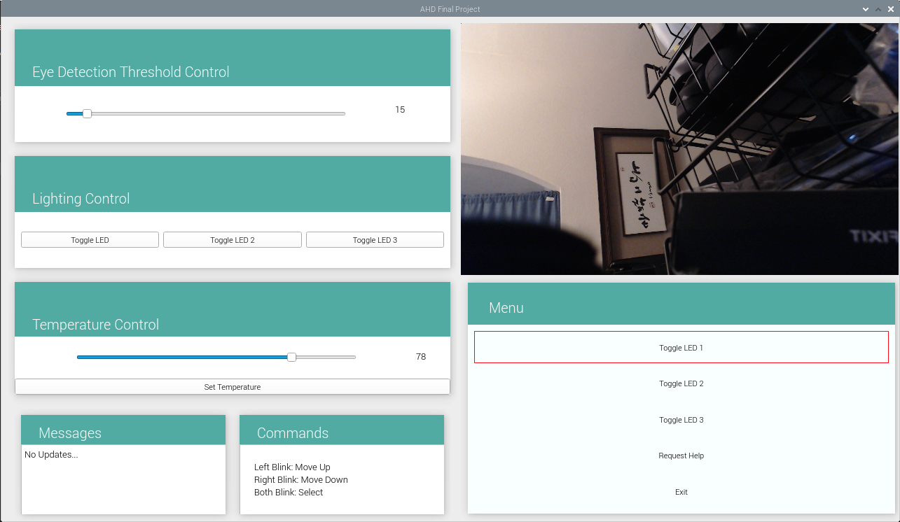
Raspberry Pi Layout

Slide 10
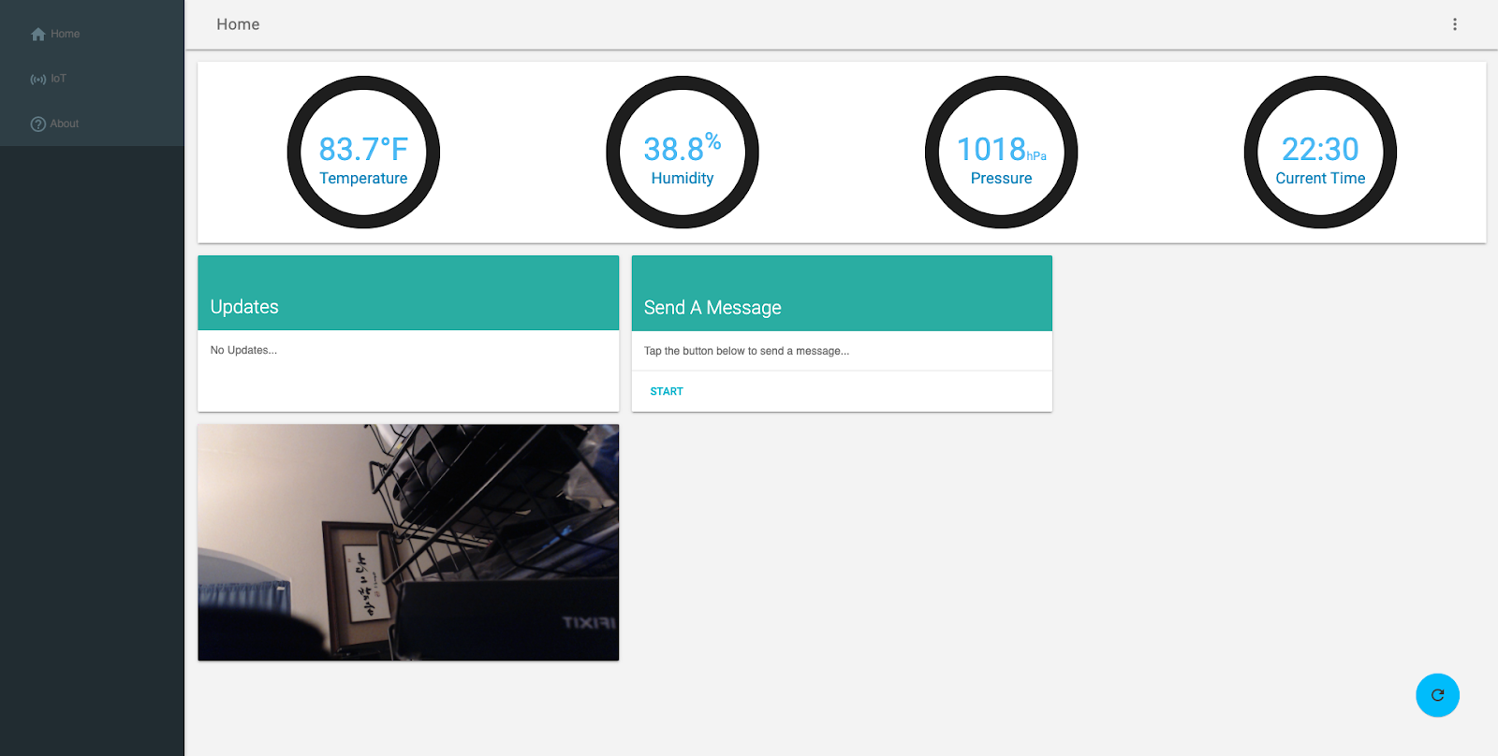
Website Layout

Slide 11
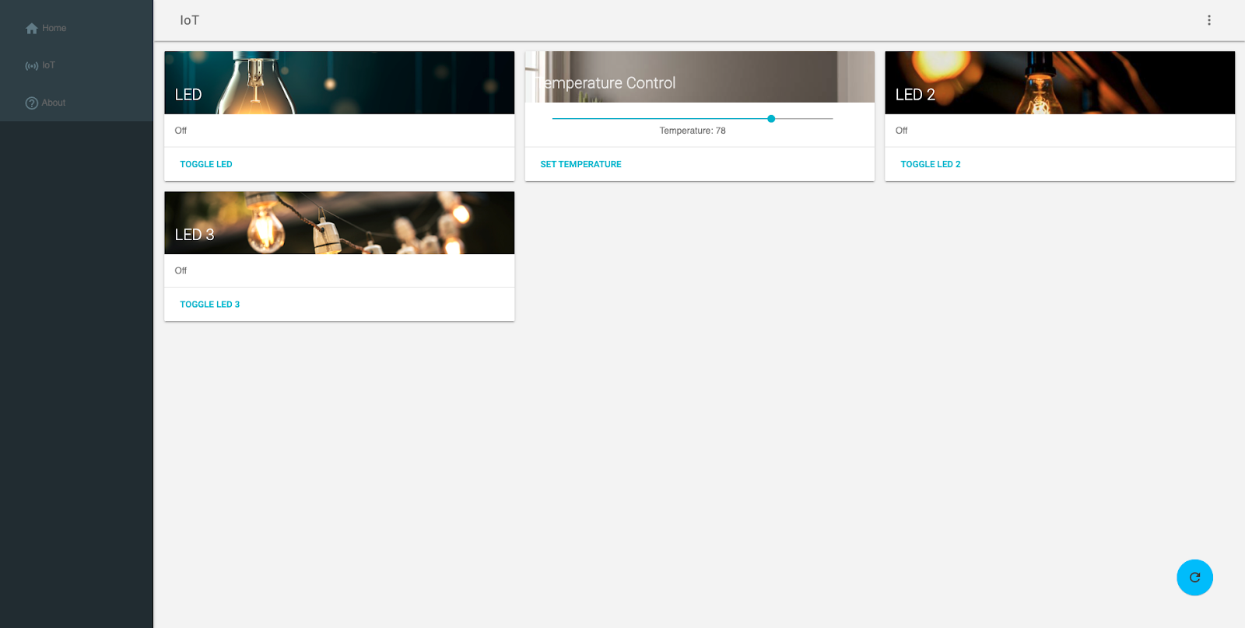
Website Layout

Slide 12
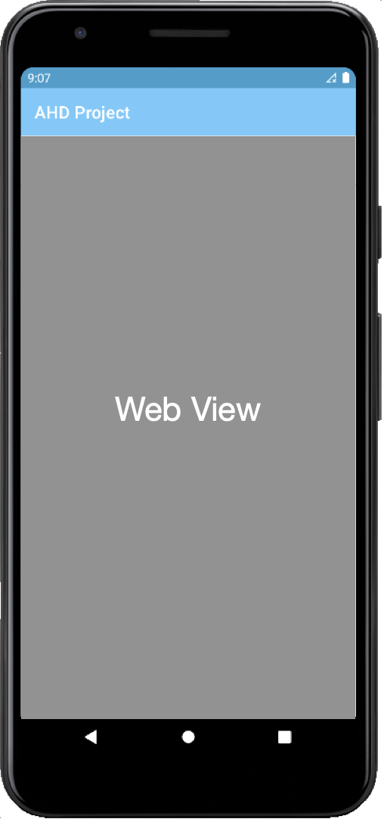
Android App Layout

Slide 13
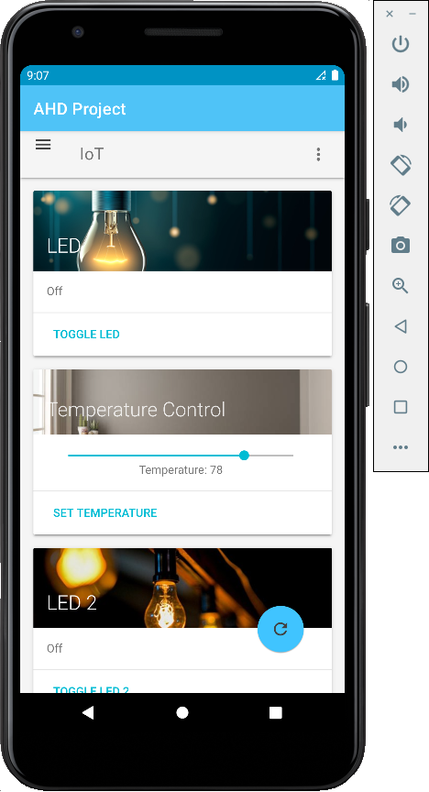
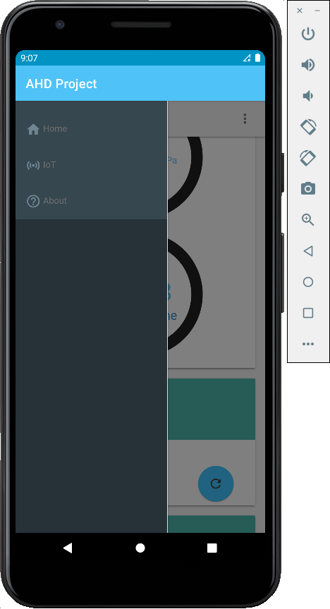
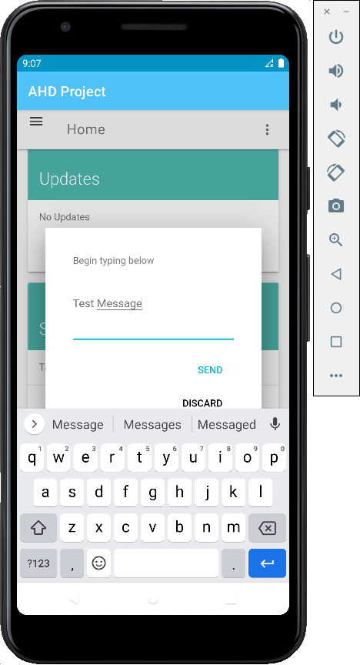
Android App Layout

Slide 14
Part 2 Modules and Scripts

Slide 15
Raspberry Pi Application Modules
Mailbox.py
GPIO_Test.py
test.py
GUI.py

Slide 16
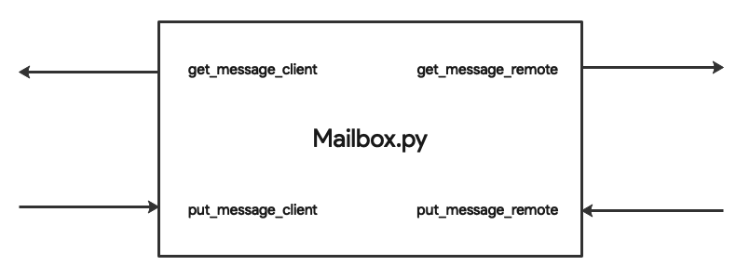
Mailbox.py
Functional Module
Used for carrying and communicating messages between the Raspberry Pi local application (GUI.py) and the web server (test.py)
4 Interfaces

Slide 17
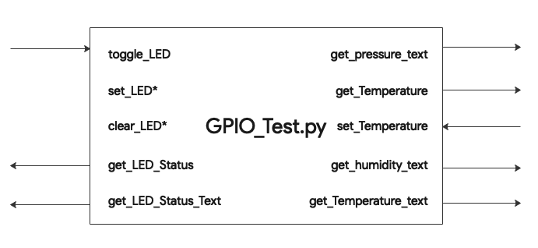
GPIO_Test.py
Functional Module
Used to control and read data from IoT devices connected to GPIO pins on the Raspberry Pi
8 External Interfaces / 2 Internal Interfaces

Slide 18
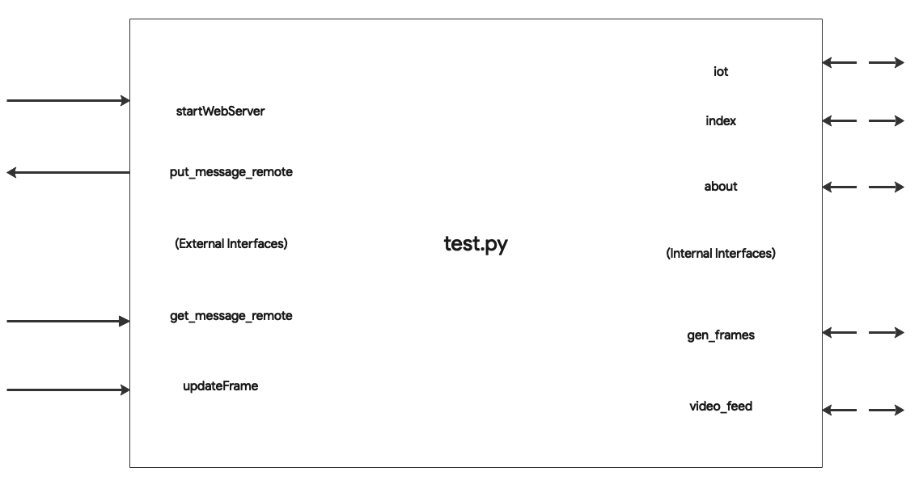
test.py
Core Module
Hosts the web server used by the Android WebApp and the website
4 External Interfaces / 5 Internal Interfaces

Slide 19
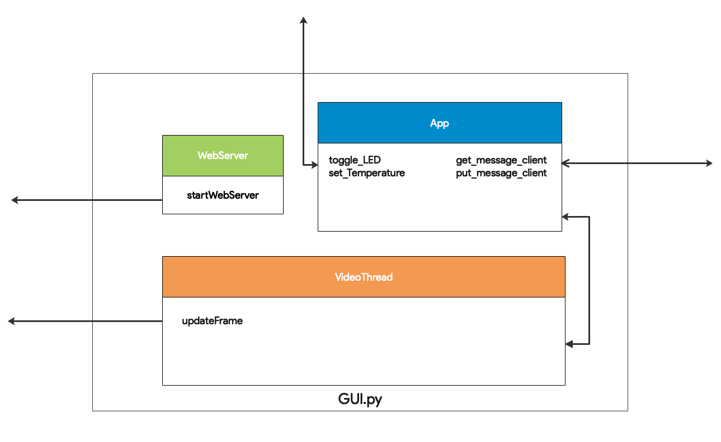
GUI.py
Main Core Module (Self-Contained Script)
Loads the local Raspberry Pi Application, starts the web server, and performs eye blinking detection
3 Classes: WebServer, App, and VideoThread

Slide 20
GUI.py Detailed
Class WebServer
Function 1: __init__(self)

Slide 21
GUI.py Detailed
Class VideoThread
Function 1: __init__(self)
Function 2: detect_faces(self, img, classifier)
Function 3: detect_eyes(self, img, classifier)
Function 4: cut_eyebrows(self, img)
Function 5: blob_process(self,img, threshold, detector)
Function 6: run(self)
Function 7: stop(self)

Slide 22

GUI.py Detailed – VideoThread FSM

Slide 23
GUI.py Detailed
Class App
Function 1: update_image(self, cv_img)
Function 2: convert_cv_qt(self, cv_img)
Function 3: changeThreshold(self, value)
Function 4: get_Temp_Slider(self)
Function 5: get_Thresholder_Slider(self)
Function 6: updateMsg(self)
Function 7: updateTemp(self)
Function 8: move_up(self)
Function 9: move_down(self)
Function 10: select(self)
Function 11: blinkControl(self)
Function 12: __init__(self)

Slide 24
Part 3 Design Compromises and Complications

Slide 25
Design Compromises and Complications
Wanted Live Streaming Video on Web Server
Wanted Native Smartphone App with OpenCV
Wanted a More Comprehensive Menu System

Slide 26
Design Compromises and Complications
Wanted Live Streaming Video on Web Server
Flask and PyQt5 requires main thread
Attempted to host 2 Flask Web Servers
Result, single frame captures thru refresh

Slide 27
Design Compromises and Complications
Wanted Native Smartphone App with OpenCV
Offload resource usage from Raspberry Pi onto smartphone
Attempted to Unity w/ C# on Android and Xcode Swift Playgrounds on iOS
Decided on WebApp for simplicty

Slide 28
Design Compromises and Complications
Wanted a More Comprehensive Menu System
More sophisticated menu structure that can be navigated and functions to be controlled
Time was a constraint
Eye blinking software had trouble, which makes navigating a bit difficult

Slide 29
Part 4 Short Demo

Slide 30
Demo

